Slide 1

.NET Framework
Asst.Prof.Dr.Derya BİRANT
329 - Windows Programming

Slide 2
Contents
1
What is .NET Framework?
2
.NET Framework Classes
3
.NET Framework Overview
4
The Evolution of .NET
5
.NET Framework Language Support
6
Application Types

Slide 3

What is .NET?
.Net is a framework for developing
  OS-platform-independent,
  Programming-language-independent,
  Windows / Web-enabled,
  Distributed
applications.

Slide 4
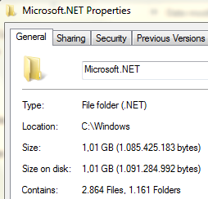
What is the .Net Framework?
The .NET Framework (now at version 4) is a revolutionary platform created by Microsoft for developing applications.
The .NET Framework consists primarily of a gigantic library of code that you use from your client languages (such as C#) using object-oriented programming (OOP) techniques.

Slide 5
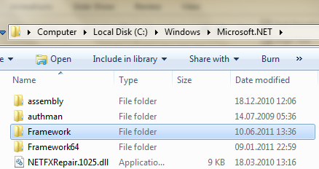
.NET Framework
The .NET framework is stored in Windows folder.

Slide 6
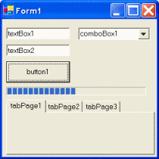
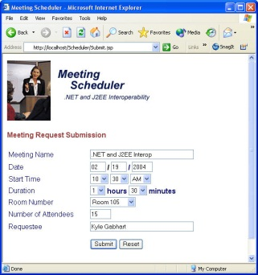
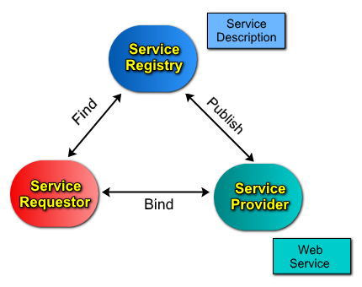
What is .NET?
A set of technologies for developing and using components to create:
  Windows Forms: A Windows Form is a vital component in the development of any Windows-based application.
  Web Forms: Web Forms are designed to make building web-based applications.
  Web Services: A web service is a platform–independent software component that contains a group of functions that are packaged together for use in a common framework throughout a network.
  …

Slide 7
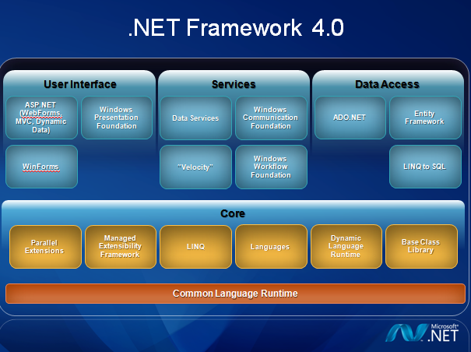
.NET Framework

Slide 8
.NET Framework
The classes are generally divided into four areas.
User interface:
  Development on the Windows platform can be done using Windows Forms.
  Provides the core Web infrastructure, such as Web Forms.
Services: Development services for programmatic functionalities.
Data Access: ADO.NET and XML provide the functionality for data access.
Core: The core base classes provide infrastructure such as parallel processing, query processing, security and transaction management.

Slide 9
Base Class Library
The .NET Framework supplies an extensive base class library, called, not surprisingly, the Base Class Library (BCL).
Some of the categories are the following:
  General base classes: Classes that provide you with an extremely powerful set of tools for a wide range of programming tasks, such as file manipulation, string manipulation, security, and encryption
  Collection classes: Classes that implement lists, dictionaries, hash tables, and bit arrays
  Threading and synchronization classes: Classes for building multithreaded programs
  XML classes: Classes for creating, reading, and manipulating XML documents

Slide 10
.NET Framework Classes
The .NET framework exposes numerous classes to the developer.
These classes allow the development of rich windows/web applications.
All of these classes are available to ALL languages.
System.Web
System.Windows.Forms
Services
UI
Form
Button
Description
HtmlControls
MessageBox
ListControl
Discovery
WebControls
Protocols
System.Drawing
Caching
Security
Drawing2D
Printing
Configuration
SessionState
Imaging
Text
System.Data
System.Xml
OLEDB
SQL
XSLT
Serialization
Design
SQLTypes
XPath
System
Collections
IO
Security
Runtime
Configuration
Net
ServiceProcess
InteropServices
Diagnostics
Reflection
Text
Remoting
Globalization
Resources
Threading
Serialization
We will explore many of these classes during this course.
Notes:
MIS 324 -- Professor Sandvig

Slide 11
.NET Overview (Goals)
Simplify: less code, easier to create and maintain
Multiple, compiled languages
Fast
Scalable
Manageable
Available
Customizable and extensible
Secure
Tool support
Automatic Browser Compatibility
Caching / Debugging

Slide 12
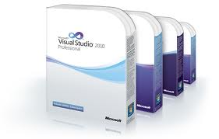
The Evolution of .NET Framework
Date | Version | Remarks
January 16, 2002 | 1.0 | First version released together with Visual Studio .NET
April 24, 2003 | 1.1 | released together with Windows Server 2003 released together with Visual Studio .NET 2003
November 7, 2005 | 2.0 | released together with Visual Studio 2005and Visual Web Developer Express and SQL Server 2005
November 21, 2006 | 3.0 | .NET Framework 3 features
November 19, 2007 | 3.5 | Released with Visual Studio 2008 andWindows Server 2008
August 11, 2008 | 3.5 Service Pack 1 | Released with Visual Studio 2008 Service Pack 1
April 12, 2010 | 4.0 | Parallel extensions and other .NET Framework 4 features

Slide 13
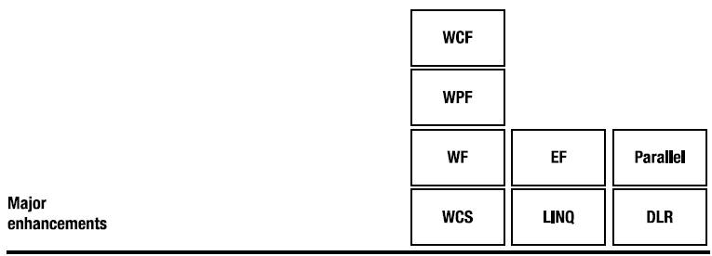
.NET Framework Versions
Each release of.NET has additional functionalities.
  WPF: Windows Presentation Foundation (Grafik, DirectX, Grafik kartları)
  WF: Windows Workflow Foundation
  WCF: Windows Communication Foundation
  WCS: Windows Card Space - storing and handling digital IDs (e.g. website registrations)
  EF: Entity Framework (exceeds the former data - management methods)
  DLR: Dynamic Language Runtime
  dynamic languages (for example, IronRuby
  and Managed JScript) are also supported.
Cloud
Computing
F#

Slide 14
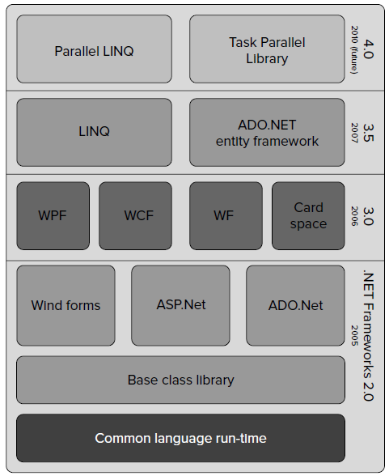
Evolution of the .NET Framework

Slide 15
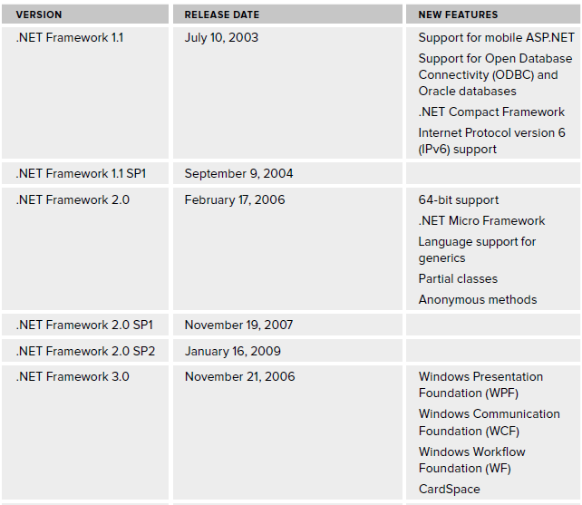
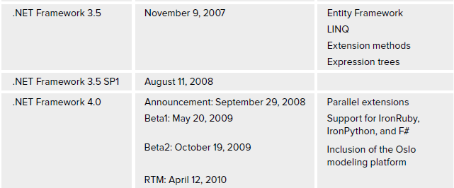

Slide 16
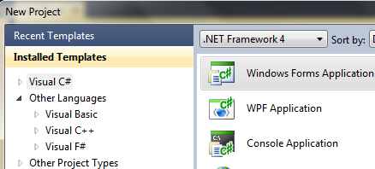
.NET Framework Language Support
You can create code in any of a large number of languages.
Support for many languages
    VB, C#, J#, C++, PERL, Python, Eiffel, Cobol, ..

Slide 17
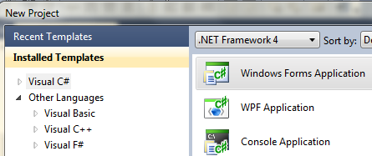
.NET Framework Language Support
There are 50+ languages that generate CIL
  CIL (Common Intermediate Language) is a Microsoft Intermediate Language
  http://www.dotnetpowered.com/languages.aspx
Most interoperate with each other

Slide 18
Interoperability
C#
if (a > b) max = a; else max = b;
C#
C++
VB
...
CIL
compiler
compiler
compiler
compiler
IL_0004: ldloc.0
IL_0005: ldloc.1
IL_0006: ble.s IL_000c
IL_0008: ldloc.0
IL_0009: stloc.2
IL_000a: br.s IL_000e
IL_000c: ldloc.1
IL_000d: stloc.2
CIL code
(+ metadata)
loader
verifier
Intel code
JIT (Just in time) compiler
mov ebx,[-4]
mov edx,[-8]
cmp ebx,edx
jle 17
mov ebx,[-4]
mov [-12],ebx
...
machine code

Slide 19
.NET Framework Language Support
VB
C++
C#
J#
Perl
Cobol
…
Common Language Specification
ASP.NET: Web Services
and Web Forms
Windows
Forms
Visual Studio.NET
ADO.NET: Data and XML
.NET Framework Base Classes
Common Language Runtime
Windows (Win32, IIS, COM+, …)
Notes:
MIS 324 -- Professor Sandvig

Slide 20
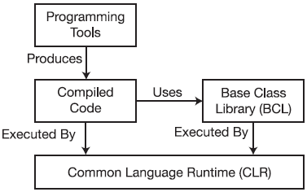
Common Language Runtime (CLR)
To make .NET language independent, CLR is defined as the runtime environment.
CLR is the central part of the .NET Framework—it executes .NET programs.
CLR is responsible for maintaining the execution of all applications developed using the .NET library.

Slide 21
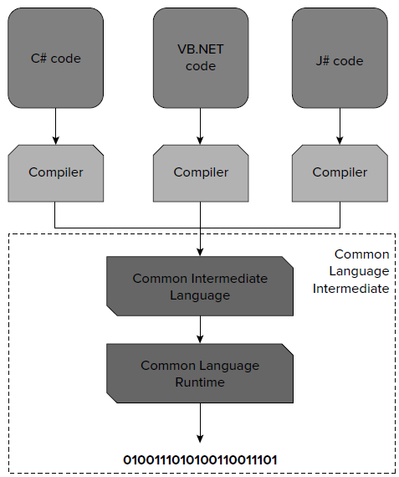
Common Language Runtime (CLR)

Slide 22
CTS and CLS
Common Type System (CTS):
  This defines the basic .NET types (such as ‘‘a 32-bit signed integer’’) of the CLR.
  All of the type definitions, collaborations between them (for example, conversions) are defined here.
Common Language Specification (CLS):
  This specifies the rules, properties, and behaviors of a programming language.
  The topics include class construction, and parameter passing.

Slide 23
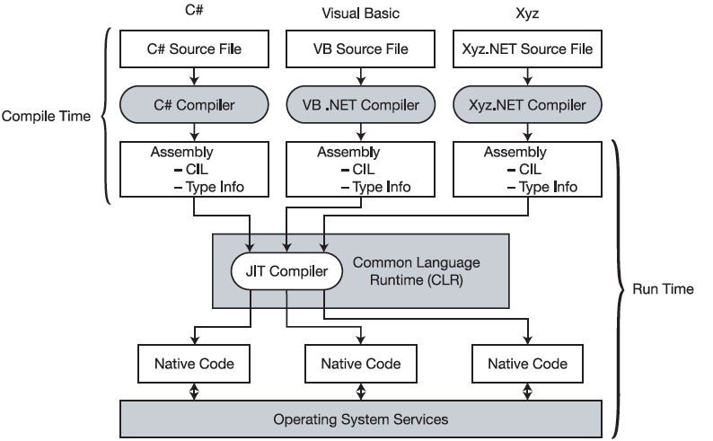
Compile-time and Runtime Processes
JIT: Just in time

Slide 24
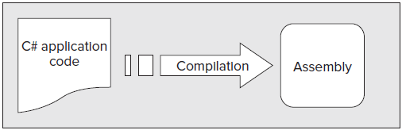
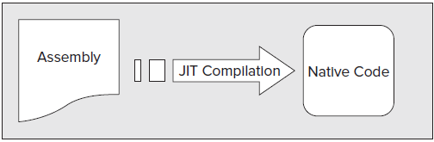
Compile-time and Runtime Processes
Code is compiled into CIL, which is stored in an assembly
When this code is executed, it must first be compiled into native code using a JIT compiler

Slide 25
CLR: Common Language Runtime
Source Code for Language 1
Source Code for Language 2
Language 1 Compiler on OS1
Language 2 Compiler on OS2
CIL Code Confirming CTS (Managed Code)
CLR on OS1
CLR on OS2
Binary Code for OS1
Binary Code for OS2
OS1
OS2
.NET Language-Independence

Slide 26
.Net Framework Overview
The most important groups are “the gang of four”:
  Windows Forms: for building GUIs for Windows applications
  ASP.NET: Active Server Pages for .building web-accessible applications.
  ADO.NET: Data Objects for accessing data in a database.
  Services: Building services

Slide 27

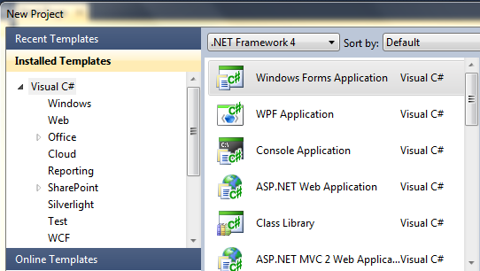










Application Types
Windows Form Application
Web Application
Console Application
WCF Service Application
WPF Application
Web Service
Class Library
Windows Form Control Library
AJAX Server Control
Silverlight Application
Reports Application

Slide 28














Developing
Services
Creating
Libraries
Developing
Applications
Communication
with Devices
Business
Hobby
Education
Faculties

Slide 29
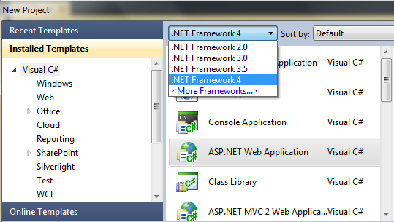
Selecting Framework
The new project dialogue contains a drop-down menu that allows you to select the version of the framework.

Slide 30
Basic Properties of .NET Framework
Independent run - time environment — All .NET languages are equal. There are no running differences, for example, between VB.NET and C#.
Clean, object - oriented basics —The object - oriented basics appeared in the various available technologies.
Full integration between the languages —Any components written on any .NET language can be used from any other components, and even written on any other .NET language.
Full interoperability with the existing programming paradigms — The .NET framework has the capability to reuse existing dynamic link library (DLL), COM, or COM+ components.
Simple deployment model — After developing a new .NET component, there is no requirement to register it or any related binaries to the Windows Registry.
Out - of - the - box base objects — The .NET Framework contains hundreds of object types that help the developers in management of the low - level Windows APIs.
General security model — The .NET Framework contains the security background itself.

Slide 31
Automatic Garbage Collection
.NET Framework has a service called the garbage collector (GC), which automatically manages memory for you.
The GC automatically removes objects from memory that your program will no longer access.

Slide 32
.NET Compact Framework
We use resource-constrained computing devices such as smart phones, PDAs, and so on.
.NET Compact Framework (CF) a hardware – independent environment for running .NET applications on mobile devices.
CF has the same architecture as the full CLR and managed code execution of the .NET Framework, but supports only a subset of the .NET classes, and contains a set of classes created especially for the CF.
.NET CF, needs around 12 MB.

Slide 33
.NET Micro Framework
The .NET Micro Framework is designed for devices with very limited resources.
It ’ s very special because it can run with or without an operating system on the device.
The typical memory requirement of MF is 200 - 500 KB.

Slide 34
See You Next Week!
Asst.Prof.Dr.Derya BİRANT
329 - Windows Programming

